Slide 1
Shapes
Урок для 3 класса
УМК «Forward» М.В. Вербицкая

Slide 2
A magic cat

Slide 3
triangle [traiæŋɡl]

Slide 4
square [skweə]

Slide 5
circle [sɜ:kl]

Slide 6
rectangle [rektæŋɡl]

Slide 7
oval [‘ǝʊvǝl]

Slide 8
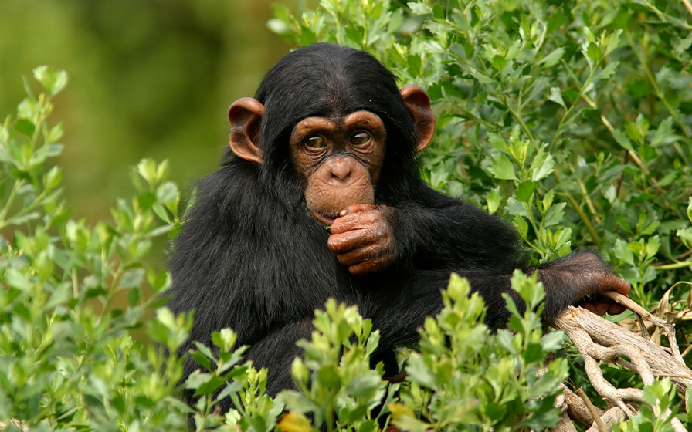
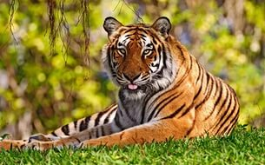
Let’s play puzzles

Slide 9
How many squares…?

Slide 10
How many squares…?

Slide 11
How many squares…?

Slide 12
Указательные местоимения
 | Близко, рядом | Далеко
Один предмет (ед. число) | this (этот, эта, это) | that (тот, та, то)
2 и более предметов (мн.число) | these (эти) | those (те)

Slide 13
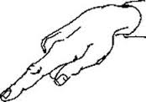
Remember!
This circle is yellow.
That circle is red.
These circles are yellow
Those circles are red.

Slide 14
Let’s practice!
This/That triangle is blue.
These/Those circles are green.
These/That rectangle is purple.
Those/These squares are yellow.

Slide 15
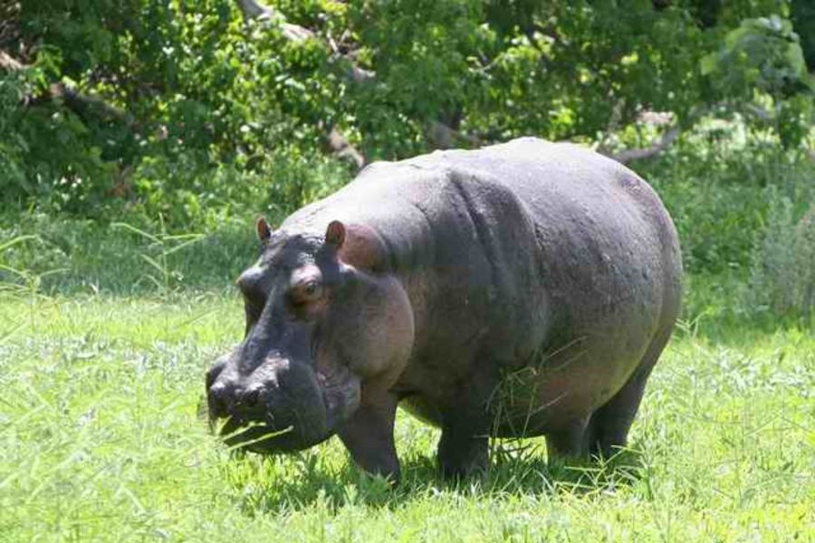
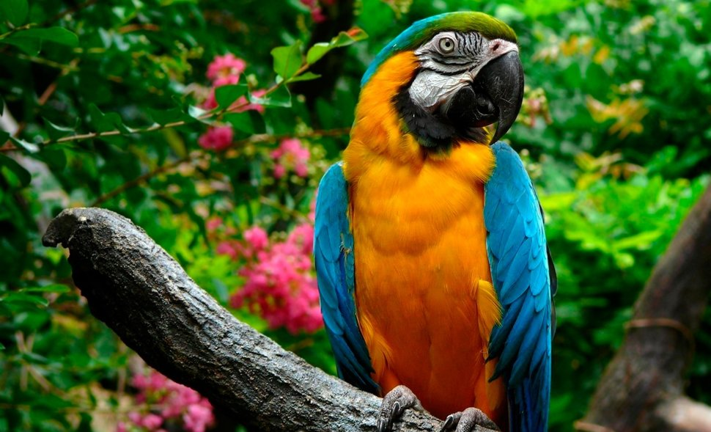
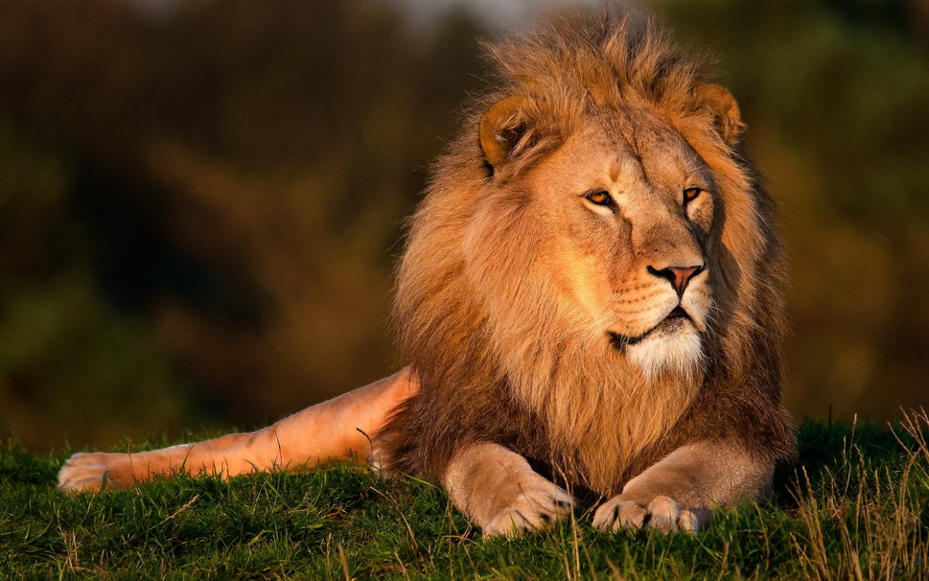
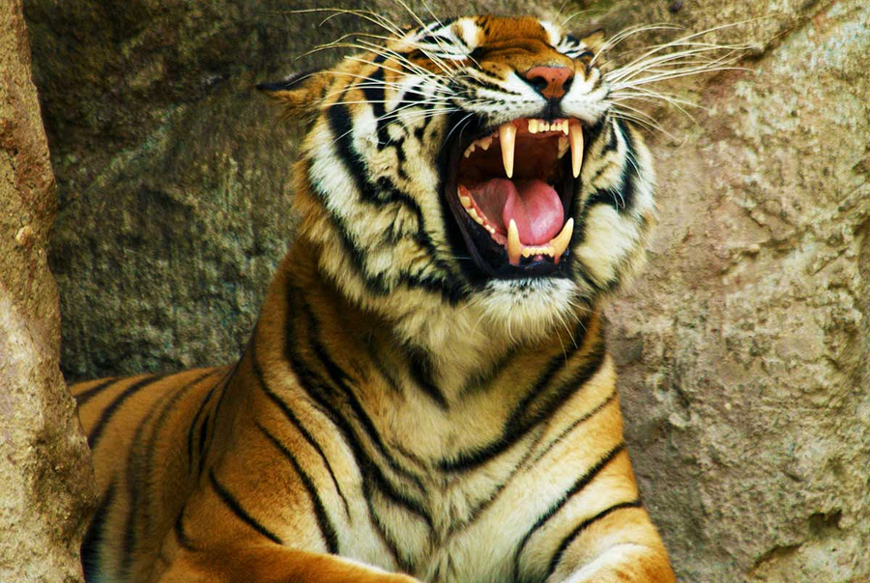
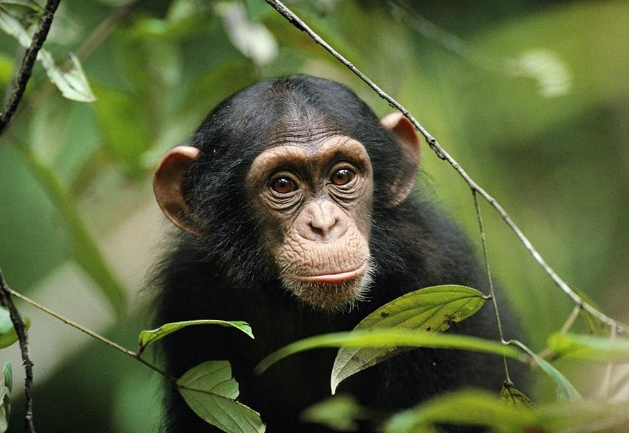
Shhh! What is it?

